Slide 2
objectives
Use digital color histograms to segment regions of interest in an image.

Slide 3
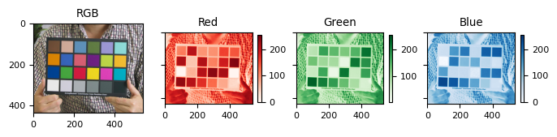
Background
Human eyes have cones and rods which allows depiction of trichromatic color and brightness, respectively. The same mechanism governs how digital cameras capture color and how devices display them accordingly. For example, a colorful image shown below is a combination of responses from the three primary channels, namely Red, Green, and Blue.
Looking closely, red colors from the RGB image have higher intensities on the red channel but have low response on the others. The same is true for the green and blue colors, respectively. Secondary colors like yellow, cyan, and magenta are a mixture of high response from two channels.

Slide 4
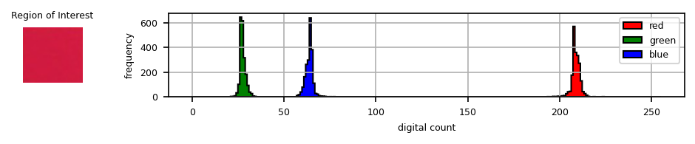
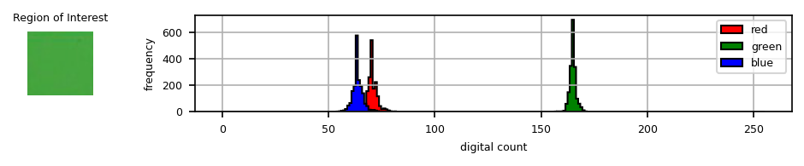
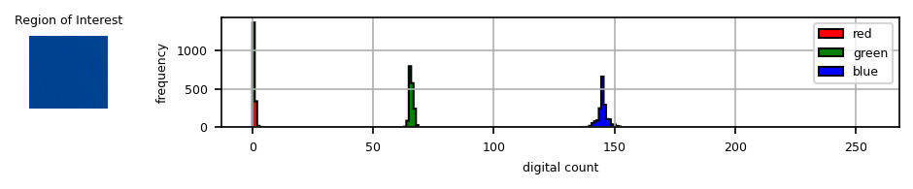
Histogram
Shown below are sample Region of Interest (ROI) which have narrow and distinct color distributions as shown by the histograms. In this activity, we first exploit ROI histograms to segment images in a technique called thresholding.

Slide 5
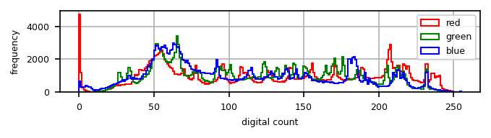
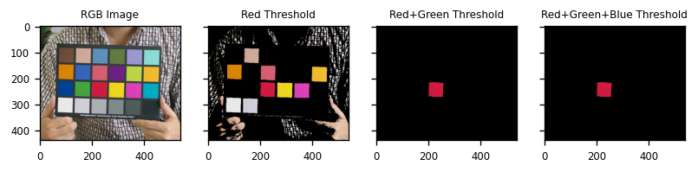
Thresholding

Slide 6
Parametric

Slide 7
Non-parametric Segmentation
Next, we employ a parametric method in which properties from the region of interest (ROI) were used. Here I transformed first the RGB values into (NCC) to represent the image in terms of r and g values, and the mean and standard deviation of r and g shall be used to compute for the joint probabilistic map assuming a gaussian probability distribution [1]. Non-parametric method uses the histogram back-projection technique which was tackled in the previous activities [1]. The said method is non-computational since it treats histograms as just look-up tables [1].

Slide 8
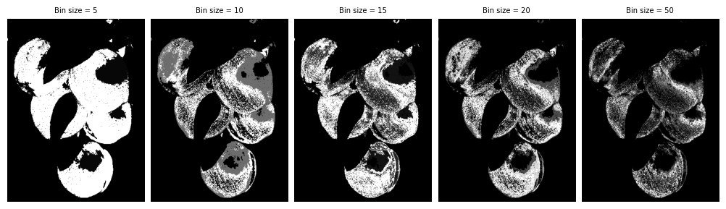
Non-Parametric

Slide 9
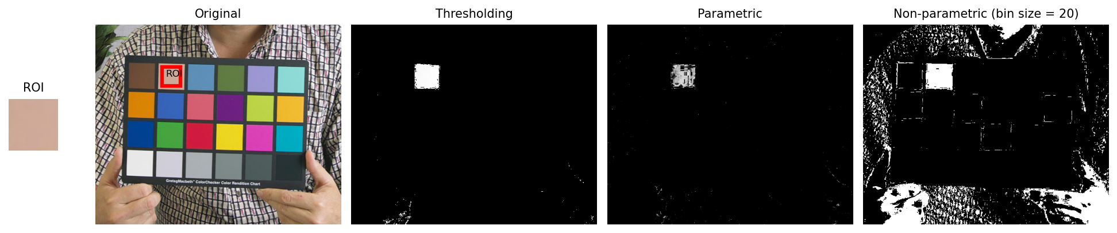
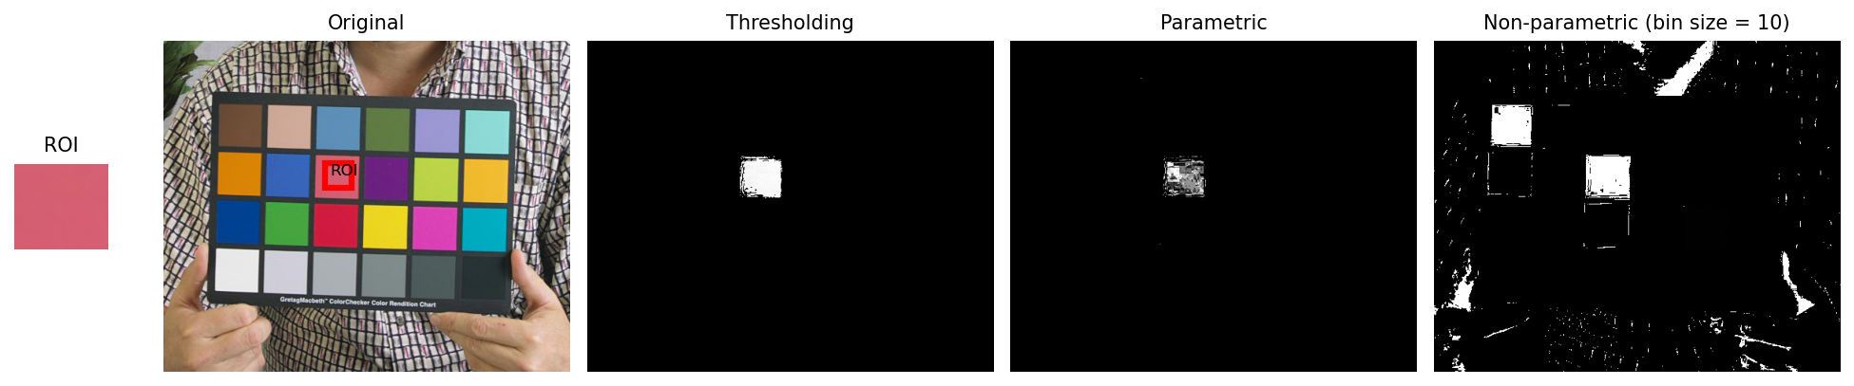

Slide 10
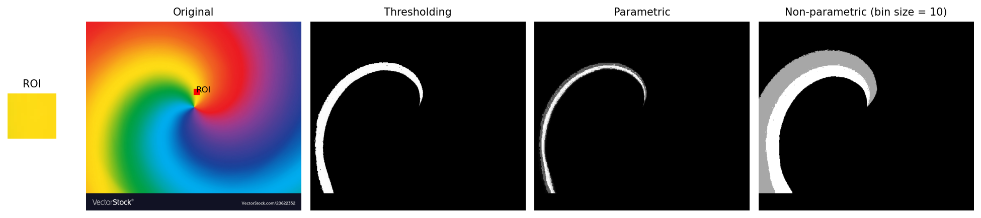
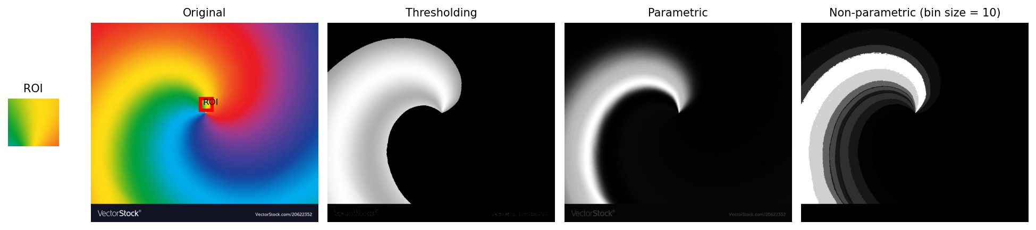

Slide 11
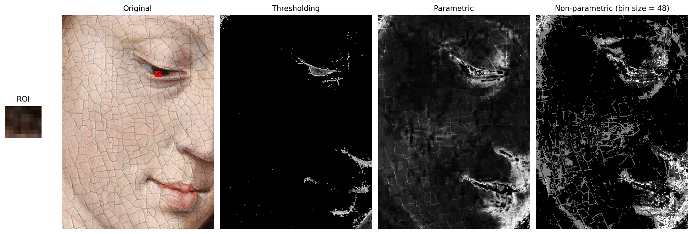

Slide 12
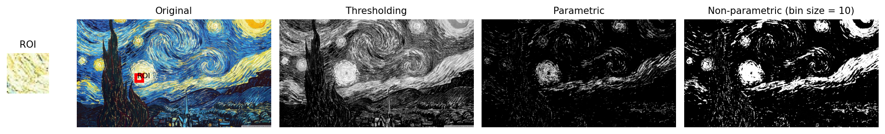
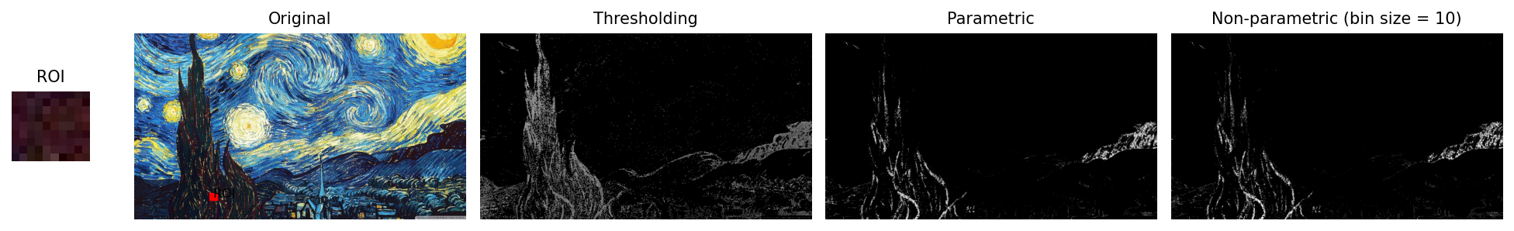
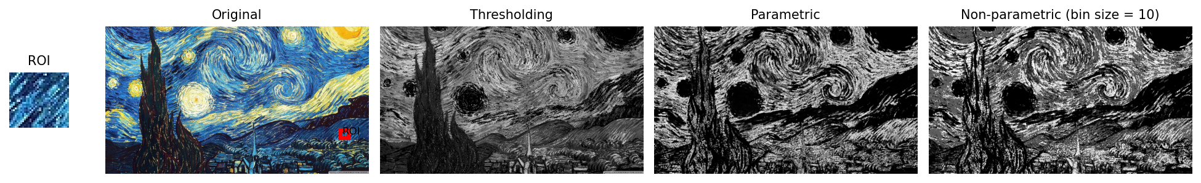

Slide 13
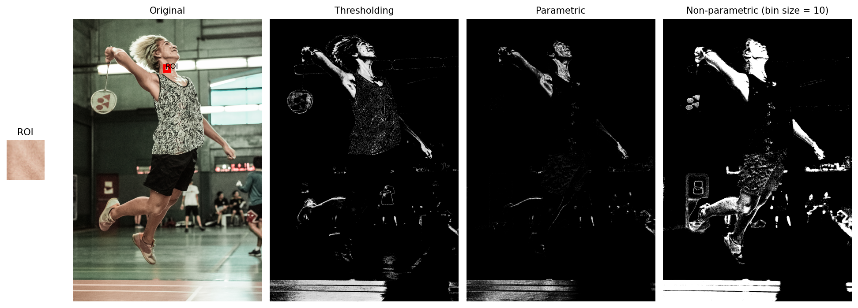
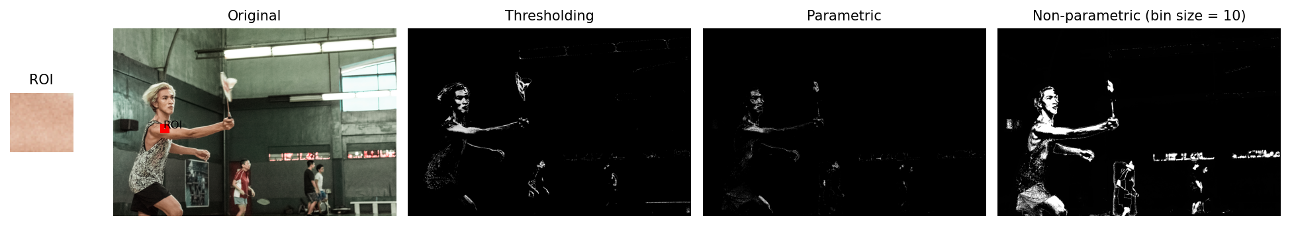
In motion

